Slide 1
Spring Boot MapStruct Example of Mapping JPA and Hibernate Entity to DTO
Using MapStruct for mapping/converting Java objects, JPA and Hibernate entity to DTO and vice versa
MapStruct is a Java annotation processor for generating bean mapping classes.
DTO, stands for Data Transfer Object, is a design pattern used for customizing/aggregating data input and output so reducing the number of call to remote API.
Java objects, JPA and Hibernate entity
DTO

Slide 2
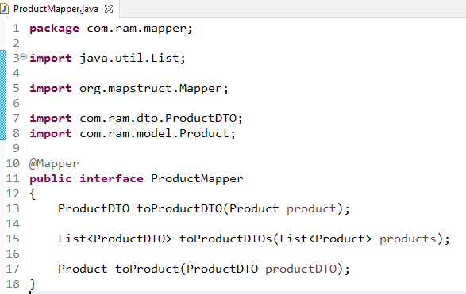
Spring Boot MapStruct Example of Mapping JPA and Hibernate Entity to DTO
To using MapStruct, you have to define a @Mapper interface which declares any required mapping methods to map between entity and DTO
Here you only define simple method signatures, converting Entity to DTO, DTO to Entity, List of Entity to List of DTOs. MapStruct will generate implementation code for you during build time.

Slide 3
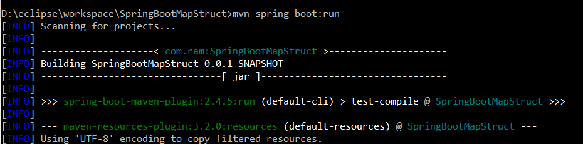
mvn spring-boot:run

